Slide 1
Matlab
JI Xiang
xiangji@sjtu.edu.cn

Slide 2
Introduction
Matlab
Simulink
Data Acquisition Toolbox

Slide 3
Matlab
plot
solve equation set

Slide 4
plot
2D plot
  linspace
  color
  marker

Slide 5
equation set

Slide 6


Cramer's Rule

Slide 7
Simulink
>>simulink
  low-cost hardware support
    Arduino
    Raspberry PI
    Analog Discovery
    etc
  simulation on line
  code generation

Slide 8
Data Acquisition Toolbox
http://cn.mathworks.com/products/daq/
Hardware Support from Data Acquisition Toolbox
  http://cn.mathworks.com/hardware-support/data-acquistion-software.html?s_tid=srchtitle

Slide 9
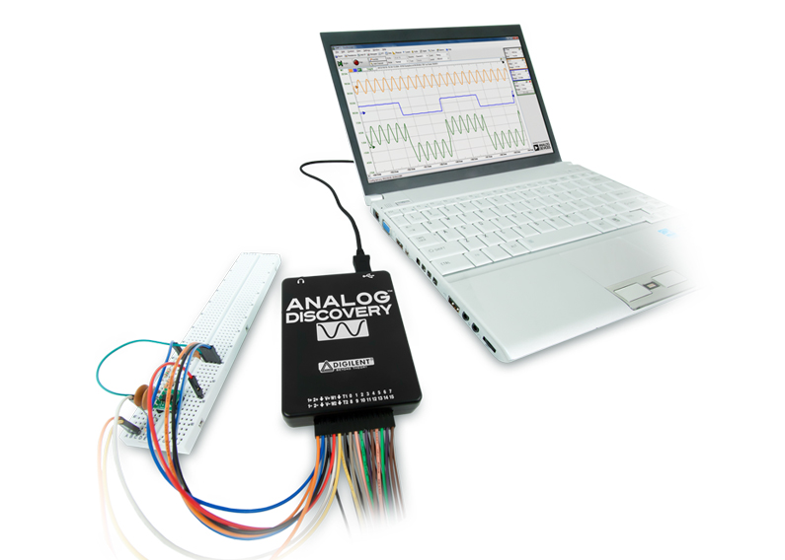
Analog Discovery

